Slide 1
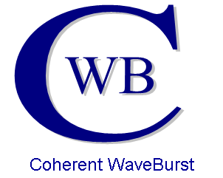


A Coherent Search for Gravitational Waves from Core Collapse Supernovae
Lex Corpuz

Slide 2
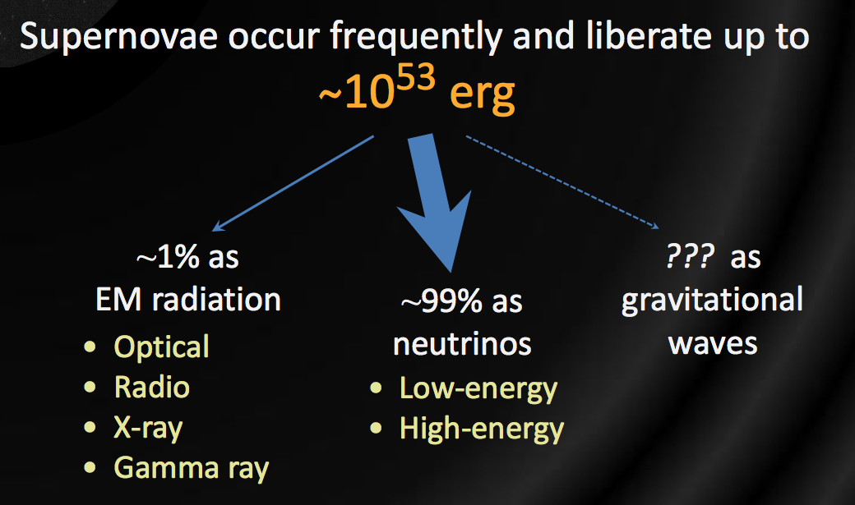
Energy
~10⁴⁶ Joules
~2.4x10³¹ Megatons
~10¹⁶ times the annual output of the sun.
Peter Shawhan GWPAW PPT February 2011

Slide 3
Waveforms
We currently are unclear as to the exact mechanism which causes a SN to actually explode.
Our List of plausible theories are:
  Convection/SASI (Neutrino/Lepton Gradients)
  Protoneutron Star g-mode pulsations
  Acoustic Bounce

Slide 4
Any GW search with a candidate event(s) must be able to answer the following questions:
Foreground
Candidate
Background
Estimation
Is the Candidate
Significant?
Yes
POSSIBLE
DETECTION!
No
Search
Sensitivity
How to calculate
an upper limit?
How to Calculate
Source rate?

Slide 5
Two Search Regimes
All-Sky Searches
Targeted Searches

Slide 6
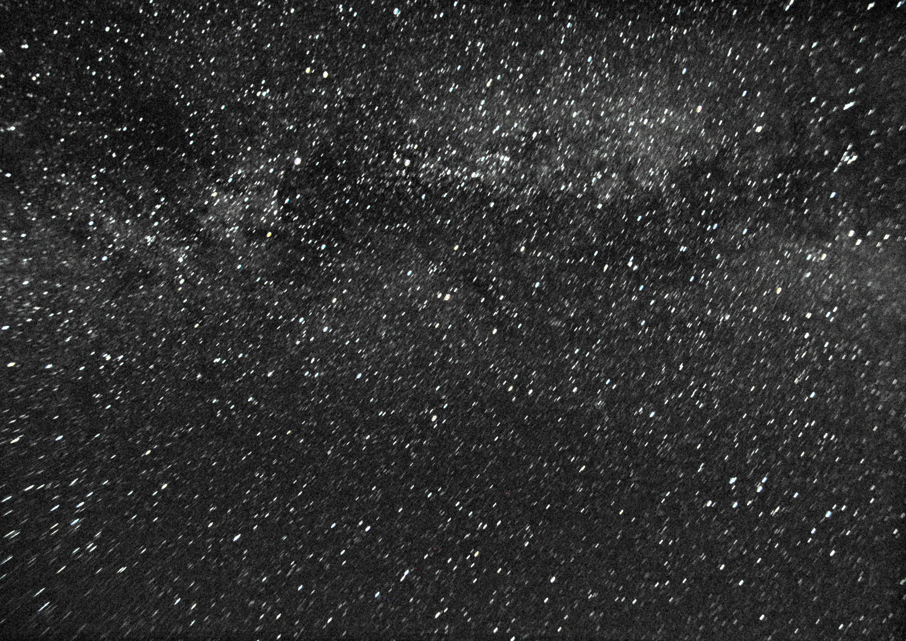
All-Sky Search

Slide 7
All-Sky Search
Pros
  You can search the whole sky at one time
Cons
  There is a lot of background and noise that generate false detections making results harder to interpret

Slide 8
Targeted Search

Slide 9
Targeted Search
Pros
  By searching only a small area (1°x1° which is only 1/129,600) we have SIGNIFICANTLY less noise and thus our results are more conclusive (we have a higher confidence in detection candidates).
Cons
  We miss everything that is entirely outside that 1°x1° region

Slide 10
How do we select a region to target?
EM Signatures (Gamma Ray Bursts, Optical, X-Ray, radio, etc…)
EM Signatures can give us the direction and the general time of an event that may have generated a gravitational wave
My search uses optically discovered supernovae and known light curves to gain both a target region AND time

Slide 11
Phase 1:
Network Sensitivities and Efficiencies

Slide 12
Our first task is to figure out how sensitive our detector network is to the region of the sky in which our target resides
We are implementing all the available interferometers we are using for our search are the Hanford 1&2, Livingston, GEO, and Virgo detectors. These are located in Washington, Louisiana, Germany, and Italy respectively.
Together, they form various networks that can be used to triangulate and measure incoming waves.

Slide 13
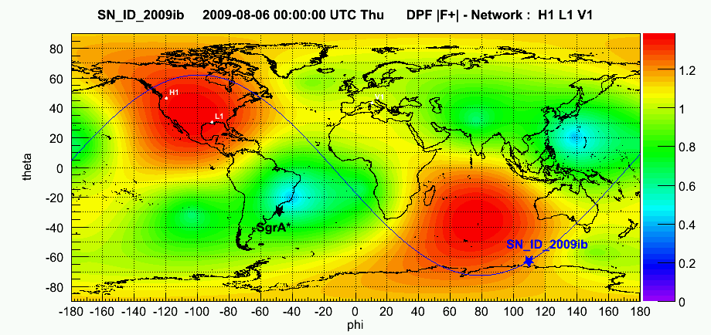
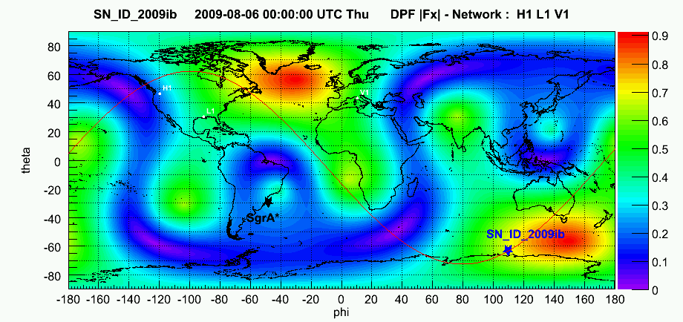
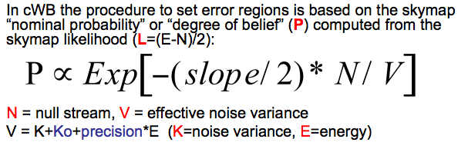

Slide 14
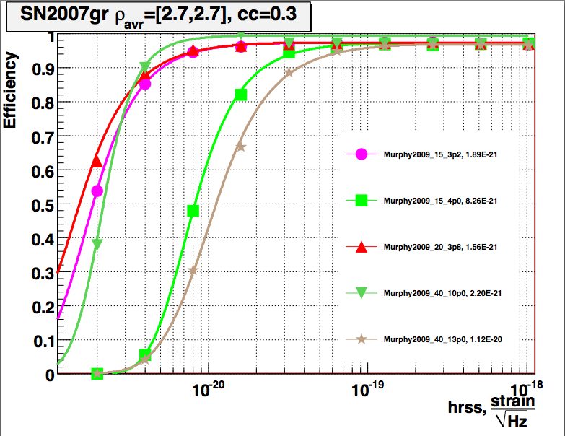
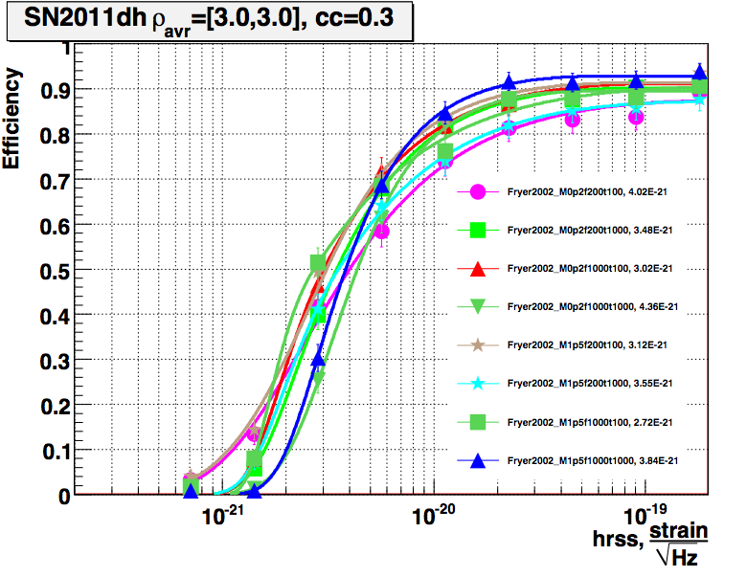
How Sensitive are our networks?
What Can we see?
4 Detector Network:
L1H1H2V1
2 Detector Network:
G1V1

Slide 15
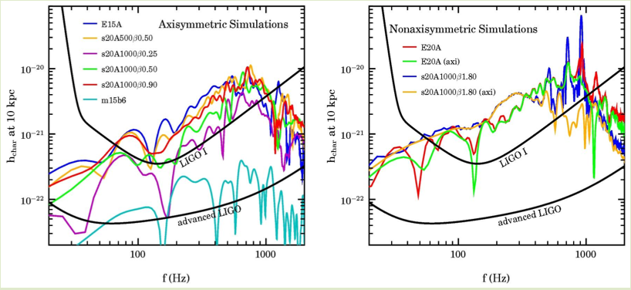
Why Can We Trust Such Small Measurements?
Let’s look at the noise:

Slide 16
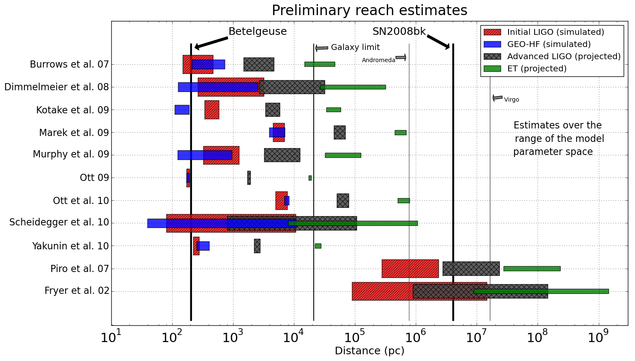
Range Estimates of Different Waveforms
Dr. Lucia Santamaria, Caltech GWPAW February Conference

Slide 17
Currently:
Phase 2:
Performing the Actual Search
To Do:
Phase 3:
Compile Search Results
Phase 4:
Producing a paper to be reviewed by the LIGO Scientific Community

